Slide 1


WSQ COURSE SLIDES
Mastering UI Design Techniques for Web and Mobile
TGS-2021010046
v12 · 14 September 2026
Tertiary Infotech Academy Pte Ltd
UEN 201200696W

Slide 2
COURSE MAP
Learning outcomes
01
02
03
04
LO1 · Identify user needs and information flows
LO2 · Develop UI prototype components
LO3 · Design and validate interfaces
LO4 · Document and export the design
›
›
›
Mastering UI Design Techniques for Web and Mobile · TGS-2021010046
2

Slide 3
ICT-DES-3008-1.1
TSC evidence chain
01
02
03
04
K1–K3 · explain mechanisms
A1–A2 · needs and flow
A3–A5 · prototype and validation
A6–A7 · document and guide
›
›
›
Mastering UI Design Techniques for Web and Mobile · TGS-2021010046
3

Slide 4
WA + PRACTICAL PERFORMANCE
Assessment briefing
Written · 60 min
Practical · 90 min
Open-ended questions test K1–K3. Use approved course materials; write in your own words.
Produce a UI flow, prototype, validation record and handoff evidence mapped to A1–A7.
Mastering UI Design Techniques for Web and Mobile · TGS-2021010046
4

Slide 5
LEARNER ACCESS
Course material on LMS
Course workspace
Courseware library
lms-tms.tertiaryinfotech.com · TGS-2021010046
Slides PDF · Learner Guide · Lesson Plan · six lab folders
Mastering UI Design Techniques for Web and Mobile · TGS-2021010046
5

Slide 6
TRAINER
Trainer profile template
Trainer name
Contact & consultation
Professional role, industry projects and teaching credentials to be completed by assigned trainer.
Introduce your relevant UI work, portfolio examples and support channel.
Mastering UI Design Techniques for Web and Mobile · TGS-2021010046
6

Slide 7
TRAINER
Dr Alfred Ang
Course developer
Evidence in this course
Dr Alfred Ang · courseware development and technical education.
Scenario briefs, prototypes, design systems, validation logs and handoff artifacts.
Mastering UI Design Techniques for Web and Mobile · TGS-2021010046
7

Slide 8
TOPIC 1 / LAB 01 / 01
User needs · Mechanism
Scenario
Design decision
A clinic patient must reschedule in under 45 seconds
Expose Reschedule beside appointment details
Mastering UI Design Techniques for Web and Mobile · TGS-2021010046
8

Slide 9
TOPIC 1 / LAB 01 / 01
User needs · Artifact
Working artifact
Booking Cancellation
booking cancellation
Expose Reschedule beside appointment details
Mastering UI Design Techniques for Web and Mobile · TGS-2021010046
9

Slide 10
TOPIC 1 / LAB 01 / 01
User needs · Flow / state
01
02
03
04
A clinic patient must reschedule in under 45 seconds
booking cancellation
Expose Reschedule beside appointment details
Review evidence
›
›
›
Mastering UI Design Techniques for Web and Mobile · TGS-2021010046
10

Slide 11
TOPIC 1 / LAB 01 / 01
User needs · Design rule
Rule
Expose Reschedule beside appointment details
A clinic patient must reschedule in under 45 seconds
Inspect the booking cancellation against the rule.
Mastering UI Design Techniques for Web and Mobile · TGS-2021010046
11

Slide 12
TOPIC 1 / LAB 01 / 01
User needs · Responsive or print check
Inspect the booking cancellation across required formats
DESKTOP / FULL SHEET
TABLET / FOLDED
MOBILE / PANEL
Mastering UI Design Techniques for Web and Mobile · TGS-2021010046
12

Slide 13
TOPIC 1 / LAB 01 / 01
User needs · Accessibility / quality
Quality criterion
CHECK → RECORD → REVISE
Verify labels, contrast, focus or print legibility for the target audience.
Readable content
Clear action
Recovery state
Capture booking cancellation as evidence.
Mastering UI Design Techniques for Web and Mobile · TGS-2021010046
13

Slide 14
TOPIC 1 / LAB 01 / 01
User needs · Failure diagnosis
Observed defect
Revised design
Hiding the control in account settings
Expose Reschedule beside appointment details
›
Mastering UI Design Techniques for Web and Mobile · TGS-2021010046
14

Slide 15
TOPIC 1 / LAB 01 / 01
User needs · Evidence to retain
01
02
03
04
Save initial booking cancellation
Change: Expose Reschedule beside appointment details
Retest same task
Keep export + evidence
›
›
›
Mastering UI Design Techniques for Web and Mobile · TGS-2021010046
15

Slide 16
TOPIC 1 / LAB 01 / 02
Research evidence · Mechanism
Scenario
Design decision
Five patients describe a cancellation path; three expect a calendar
Map the observed intent before drawing screens
Mastering UI Design Techniques for Web and Mobile · TGS-2021010046
16

Slide 17
TOPIC 1 / LAB 01 / 02
Research evidence · Artifact
Working artifact
Task Interview
task interview
Map the observed intent before drawing screens
Mastering UI Design Techniques for Web and Mobile · TGS-2021010046
17

Slide 18
TOPIC 1 / LAB 01 / 02
Research evidence · Flow / state
01
02
03
04
Five patients describe a cancellation path
task interview
Map the observed intent before drawing screens
Review evidence
›
›
›
Mastering UI Design Techniques for Web and Mobile · TGS-2021010046
18

Slide 19
TOPIC 1 / LAB 01 / 02
Research evidence · Design rule
Rule
Map the observed intent before drawing screens
Five patients describe a cancellation path; three expect a calendar
Inspect the task interview against the rule.
Mastering UI Design Techniques for Web and Mobile · TGS-2021010046
19

Slide 20
TOPIC 1 / LAB 01 / 02
Research evidence · Responsive or print check
Inspect the task interview across required formats
DESKTOP / FULL SHEET
TABLET / FOLDED
MOBILE / PANEL
Mastering UI Design Techniques for Web and Mobile · TGS-2021010046
20

Slide 21
TOPIC 1 / LAB 01 / 02
Research evidence · Accessibility / quality
Quality criterion
CHECK → RECORD → REVISE
Verify labels, contrast, focus or print legibility for the target audience.
Readable content
Clear action
Recovery state
Capture task interview as evidence.
Mastering UI Design Techniques for Web and Mobile · TGS-2021010046
21

Slide 22
TOPIC 1 / LAB 01 / 02
Research evidence · Failure diagnosis
Observed defect
Revised design
Treating a designer assumption as evidence
Map the observed intent before drawing screens
›
Mastering UI Design Techniques for Web and Mobile · TGS-2021010046
22

Slide 23
TOPIC 1 / LAB 01 / 02
Research evidence · Evidence to retain
01
02
03
04
Save initial task interview
Change: Map the observed intent before drawing screens
Retest same task
Keep export + evidence
›
›
›
Mastering UI Design Techniques for Web and Mobile · TGS-2021010046
23

Slide 24
TOPIC 1 / LAB 01 / 03
Persona constraint · Mechanism
Scenario
Design decision
A 52-year-old patient uses 200% text on a train
Keep labels and actions legible at zoom
Mastering UI Design Techniques for Web and Mobile · TGS-2021010046
24

Slide 25
TOPIC 1 / LAB 01 / 03
Persona constraint · Artifact
Working artifact
Low-Vision Commuter
low-vision commuter
Keep labels and actions legible at zoom
Mastering UI Design Techniques for Web and Mobile · TGS-2021010046
25

Slide 26
TOPIC 1 / LAB 01 / 03
Persona constraint · Flow / state
01
02
03
04
A 52-year-old patient uses 200% text on a train
low-vision commuter
Keep labels and actions legible at zoom
Review evidence
›
›
›
Mastering UI Design Techniques for Web and Mobile · TGS-2021010046
26

Slide 27
TOPIC 1 / LAB 01 / 03
Persona constraint · Design rule
Rule
Keep labels and actions legible at zoom
A 52-year-old patient uses 200% text on a train
Inspect the low-vision commuter against the rule.
Mastering UI Design Techniques for Web and Mobile · TGS-2021010046
27

Slide 28
TOPIC 1 / LAB 01 / 03
Persona constraint · Responsive or print check
Inspect the low-vision commuter across required formats
DESKTOP / FULL SHEET
TABLET / FOLDED
MOBILE / PANEL
Mastering UI Design Techniques for Web and Mobile · TGS-2021010046
28

Slide 29
TOPIC 1 / LAB 01 / 03
Persona constraint · Accessibility / quality
Quality criterion
CHECK → RECORD → REVISE
Verify labels, contrast, focus or print legibility for the target audience.
Readable content
Clear action
Recovery state
Capture low-vision commuter as evidence.
Mastering UI Design Techniques for Web and Mobile · TGS-2021010046
29

Slide 30
TOPIC 1 / LAB 01 / 03
Persona constraint · Failure diagnosis
Observed defect
Revised design
Using tiny icon-only actions
Keep labels and actions legible at zoom
›
Mastering UI Design Techniques for Web and Mobile · TGS-2021010046
30

Slide 31
TOPIC 1 / LAB 01 / 03
Persona constraint · Evidence to retain
01
02
03
04
Save initial low-vision commuter
Change: Keep labels and actions legible at zoom
Retest same task
Keep export + evidence
›
›
›
Mastering UI Design Techniques for Web and Mobile · TGS-2021010046
31

Slide 32
TOPIC 1 / LAB 01 / 04
Journey mapping · Mechanism
Scenario
Design decision
A slot disappears between search and confirmation
Return to available slots with criteria retained
Mastering UI Design Techniques for Web and Mobile · TGS-2021010046
32

Slide 33
TOPIC 1 / LAB 01 / 04
Journey mapping · Artifact
Working artifact
Failed-Slot Recovery
failed-slot recovery
Return to available slots with criteria retained
Mastering UI Design Techniques for Web and Mobile · TGS-2021010046
33

Slide 34
TOPIC 1 / LAB 01 / 04
Journey mapping · Flow / state
01
02
03
04
A slot disappears between search and confirmation
failed-slot recovery
Return to available slots with criteria retained
Review evidence
›
›
›
Mastering UI Design Techniques for Web and Mobile · TGS-2021010046
34

Slide 35
TOPIC 1 / LAB 01 / 04
Journey mapping · Design rule
Rule
Return to available slots with criteria retained
A slot disappears between search and confirmation
Inspect the failed-slot recovery against the rule.
Mastering UI Design Techniques for Web and Mobile · TGS-2021010046
35

Slide 36
TOPIC 1 / LAB 01 / 04
Journey mapping · Responsive or print check
Inspect the failed-slot recovery across required formats
DESKTOP / FULL SHEET
TABLET / FOLDED
MOBILE / PANEL
Mastering UI Design Techniques for Web and Mobile · TGS-2021010046
36

Slide 37
TOPIC 1 / LAB 01 / 04
Journey mapping · Accessibility / quality
Quality criterion
CHECK → RECORD → REVISE
Verify labels, contrast, focus or print legibility for the target audience.
Readable content
Clear action
Recovery state
Capture failed-slot recovery as evidence.
Mastering UI Design Techniques for Web and Mobile · TGS-2021010046
37

Slide 38
TOPIC 1 / LAB 01 / 04
Journey mapping · Failure diagnosis
Observed defect
Revised design
Resetting search and losing intent
Return to available slots with criteria retained
›
Mastering UI Design Techniques for Web and Mobile · TGS-2021010046
38

Slide 39
TOPIC 1 / LAB 01 / 04
Journey mapping · Evidence to retain
01
02
03
04
Save initial failed-slot recovery
Change: Return to available slots with criteria retained
Retest same task
Keep export + evidence
›
›
›
Mastering UI Design Techniques for Web and Mobile · TGS-2021010046
39

Slide 40
TOPIC 1 / LAB 01 / 05
Information architecture · Mechanism
Scenario
Design decision
Appointments, care teams and account are separate objects
Use task-based primary navigation
Mastering UI Design Techniques for Web and Mobile · TGS-2021010046
40

Slide 41
TOPIC 1 / LAB 01 / 05
Information architecture · Artifact
Working artifact
Clinic Navigation
clinic navigation
Use task-based primary navigation
Mastering UI Design Techniques for Web and Mobile · TGS-2021010046
41

Slide 42
TOPIC 1 / LAB 01 / 05
Information architecture · Flow / state
01
02
03
04
Appointments, care teams and account are separate objects
clinic navigation
Use task-based primary navigation
Review evidence
›
›
›
Mastering UI Design Techniques for Web and Mobile · TGS-2021010046
42

Slide 43
TOPIC 1 / LAB 01 / 05
Information architecture · Design rule
Rule
Use task-based primary navigation
Appointments, care teams and account are separate objects
Inspect the clinic navigation against the rule.
Mastering UI Design Techniques for Web and Mobile · TGS-2021010046
43

Slide 44
TOPIC 1 / LAB 01 / 05
Information architecture · Responsive or print check
Inspect the clinic navigation across required formats
DESKTOP / FULL SHEET
TABLET / FOLDED
MOBILE / PANEL
Mastering UI Design Techniques for Web and Mobile · TGS-2021010046
44

Slide 45
TOPIC 1 / LAB 01 / 05
Information architecture · Accessibility / quality
Quality criterion
CHECK → RECORD → REVISE
Verify labels, contrast, focus or print legibility for the target audience.
Readable content
Clear action
Recovery state
Capture clinic navigation as evidence.
Mastering UI Design Techniques for Web and Mobile · TGS-2021010046
45

Slide 46
TOPIC 1 / LAB 01 / 05
Information architecture · Failure diagnosis
Observed defect
Revised design
Organising menus by internal department
Use task-based primary navigation
›
Mastering UI Design Techniques for Web and Mobile · TGS-2021010046
46

Slide 47
TOPIC 1 / LAB 01 / 05
Information architecture · Evidence to retain
01
02
03
04
Save initial clinic navigation
Change: Use task-based primary navigation
Retest same task
Keep export + evidence
›
›
›
Mastering UI Design Techniques for Web and Mobile · TGS-2021010046
47

Slide 48
TOPIC 1 / LAB 01 / 06
Information flow · Mechanism
Scenario
Design decision
Search → select → verify → confirm → receipt
Track state and data at each transition
Mastering UI Design Techniques for Web and Mobile · TGS-2021010046
48

Slide 49
TOPIC 1 / LAB 01 / 06
Information flow · Artifact
Working artifact
Booking State Graph
booking state graph
Track state and data at each transition
Mastering UI Design Techniques for Web and Mobile · TGS-2021010046
49

Slide 50
TOPIC 1 / LAB 01 / 06
Information flow · Flow / state
01
02
03
04
Search → select → verify → confirm → receipt
booking state graph
Track state and data at each transition
Review evidence
›
›
›
Mastering UI Design Techniques for Web and Mobile · TGS-2021010046
50

Slide 51
TOPIC 1 / LAB 01 / 06
Information flow · Design rule
Rule
Track state and data at each transition
Search → select → verify → confirm → receipt
Inspect the booking state graph against the rule.
Mastering UI Design Techniques for Web and Mobile · TGS-2021010046
51

Slide 52
TOPIC 1 / LAB 01 / 06
Information flow · Responsive or print check
Inspect the booking state graph across required formats
DESKTOP / FULL SHEET
TABLET / FOLDED
MOBILE / PANEL
Mastering UI Design Techniques for Web and Mobile · TGS-2021010046
52

Slide 53
TOPIC 1 / LAB 01 / 06
Information flow · Accessibility / quality
Quality criterion
CHECK → RECORD → REVISE
Verify labels, contrast, focus or print legibility for the target audience.
Readable content
Clear action
Recovery state
Capture booking state graph as evidence.
Mastering UI Design Techniques for Web and Mobile · TGS-2021010046
53

Slide 54
TOPIC 1 / LAB 01 / 06
Information flow · Failure diagnosis
Observed defect
Revised design
No route back from verification error
Track state and data at each transition
›
Mastering UI Design Techniques for Web and Mobile · TGS-2021010046
54

Slide 55
TOPIC 1 / LAB 01 / 06
Information flow · Evidence to retain
01
02
03
04
Save initial booking state graph
Change: Track state and data at each transition
Retest same task
Keep export + evidence
›
›
›
Mastering UI Design Techniques for Web and Mobile · TGS-2021010046
55

Slide 56
TOPIC 2 / LAB 01 / 07
Wireframe fidelity · Mechanism
Scenario
Design decision
Header, appointment card and primary action must fit 390 px
Validate hierarchy before visual polish
Mastering UI Design Techniques for Web and Mobile · TGS-2021010046
56

Slide 57
TOPIC 2 / LAB 01 / 07
Wireframe fidelity · Artifact
Working artifact
Booking Screen Structure
booking screen structure
Validate hierarchy before visual polish
Mastering UI Design Techniques for Web and Mobile · TGS-2021010046
57

Slide 58
TOPIC 2 / LAB 01 / 07
Wireframe fidelity · Flow / state
01
02
03
04
Header, appointment card and primary action must fit 390 px
booking screen structure
Validate hierarchy before visual polish
Review evidence
›
›
›
Mastering UI Design Techniques for Web and Mobile · TGS-2021010046
58

Slide 59
TOPIC 2 / LAB 01 / 07
Wireframe fidelity · Design rule
Rule
Validate hierarchy before visual polish
Header, appointment card and primary action must fit 390 px
Inspect the booking screen structure against the rule.
Mastering UI Design Techniques for Web and Mobile · TGS-2021010046
59

Slide 60
TOPIC 2 / LAB 01 / 07
Wireframe fidelity · Responsive or print check
Inspect the booking screen structure across required formats
DESKTOP / FULL SHEET
TABLET / FOLDED
MOBILE / PANEL
Mastering UI Design Techniques for Web and Mobile · TGS-2021010046
60

Slide 61
TOPIC 2 / LAB 01 / 07
Wireframe fidelity · Accessibility / quality
Quality criterion
CHECK → RECORD → REVISE
Verify labels, contrast, focus or print legibility for the target audience.
Readable content
Clear action
Recovery state
Capture booking screen structure as evidence.
Mastering UI Design Techniques for Web and Mobile · TGS-2021010046
61

Slide 62
TOPIC 2 / LAB 01 / 07
Wireframe fidelity · Failure diagnosis
Observed defect
Revised design
Starting with decorative imagery
Validate hierarchy before visual polish
›
Mastering UI Design Techniques for Web and Mobile · TGS-2021010046
62

Slide 63
TOPIC 2 / LAB 01 / 07
Wireframe fidelity · Evidence to retain
01
02
03
04
Save initial booking screen structure
Change: Validate hierarchy before visual polish
Retest same task
Keep export + evidence
›
›
›
Mastering UI Design Techniques for Web and Mobile · TGS-2021010046
63

Slide 64
TOPIC 2 / LAB 01 / 08
Prompt specification · Mechanism
Scenario
Design decision
Define audience, task, constraints, breakpoints and success criteria
Give Claude a testable design brief
Mastering UI Design Techniques for Web and Mobile · TGS-2021010046
64

Slide 65
TOPIC 2 / LAB 01 / 08
Prompt specification · Artifact
Working artifact
Claude Design Brief
Claude Design brief
Give Claude a testable design brief
Mastering UI Design Techniques for Web and Mobile · TGS-2021010046
65

Slide 66
TOPIC 2 / LAB 01 / 08
Prompt specification · Flow / state
01
02
03
04
Define audience, task, constraints, breakpoints and success criteria
Claude Design brief
Give Claude a testable design brief
Review evidence
›
›
›
Mastering UI Design Techniques for Web and Mobile · TGS-2021010046
66

Slide 67
TOPIC 2 / LAB 01 / 08
Prompt specification · Design rule
Rule
Give Claude a testable design brief
Define audience, task, constraints, breakpoints and success criteria
Inspect the Claude Design brief against the rule.
Mastering UI Design Techniques for Web and Mobile · TGS-2021010046
67

Slide 68
TOPIC 2 / LAB 01 / 08
Prompt specification · Responsive or print check
Inspect the Claude Design brief across required formats
DESKTOP / FULL SHEET
TABLET / FOLDED
MOBILE / PANEL
Mastering UI Design Techniques for Web and Mobile · TGS-2021010046
68

Slide 69
TOPIC 2 / LAB 01 / 08
Prompt specification · Accessibility / quality
Quality criterion
CHECK → RECORD → REVISE
Verify labels, contrast, focus or print legibility for the target audience.
Readable content
Clear action
Recovery state
Capture Claude Design brief as evidence.
Mastering UI Design Techniques for Web and Mobile · TGS-2021010046
69

Slide 70
TOPIC 2 / LAB 01 / 08
Prompt specification · Failure diagnosis
Observed defect
Revised design
Prompting only “make it modern”
Give Claude a testable design brief
›
Mastering UI Design Techniques for Web and Mobile · TGS-2021010046
70

Slide 71
TOPIC 2 / LAB 01 / 08
Prompt specification · Evidence to retain
01
02
03
04
Save initial Claude Design brief
Change: Give Claude a testable design brief
Retest same task
Keep export + evidence
›
›
›
Mastering UI Design Techniques for Web and Mobile · TGS-2021010046
71

Slide 72
TOPIC 2 / LAB 02 / 09
Responsive layout · Mechanism
Scenario
Design decision
A 4-column grid becomes 2 columns then 1
Preserve product order and card action
Mastering UI Design Techniques for Web and Mobile · TGS-2021010046
72

Slide 73
TOPIC 2 / LAB 02 / 09
Responsive layout · Artifact
Working artifact
Retail Product Grid
retail product grid
Preserve product order and card action
Mastering UI Design Techniques for Web and Mobile · TGS-2021010046
73

Slide 74
TOPIC 2 / LAB 02 / 09
Responsive layout · Flow / state
01
02
03
04
A 4-column grid becomes 2 columns then 1
retail product grid
Preserve product order and card action
Review evidence
›
›
›
Mastering UI Design Techniques for Web and Mobile · TGS-2021010046
74

Slide 75
TOPIC 2 / LAB 02 / 09
Responsive layout · Design rule
Rule
Preserve product order and card action
A 4-column grid becomes 2 columns then 1
Inspect the retail product grid against the rule.
Mastering UI Design Techniques for Web and Mobile · TGS-2021010046
75

Slide 76
TOPIC 2 / LAB 02 / 09
Responsive layout · Responsive or print check
Inspect the retail product grid across required formats
DESKTOP / FULL SHEET
TABLET / FOLDED
MOBILE / PANEL
Mastering UI Design Techniques for Web and Mobile · TGS-2021010046
76

Slide 77
TOPIC 2 / LAB 02 / 09
Responsive layout · Accessibility / quality
Quality criterion
CHECK → RECORD → REVISE
Verify labels, contrast, focus or print legibility for the target audience.
Readable content
Clear action
Recovery state
Capture retail product grid as evidence.
Mastering UI Design Techniques for Web and Mobile · TGS-2021010046
77

Slide 78
TOPIC 2 / LAB 02 / 09
Responsive layout · Failure diagnosis
Observed defect
Revised design
Shrinking four columns onto a phone
Preserve product order and card action
›
Mastering UI Design Techniques for Web and Mobile · TGS-2021010046
78

Slide 79
TOPIC 2 / LAB 02 / 09
Responsive layout · Evidence to retain
01
02
03
04
Save initial retail product grid
Change: Preserve product order and card action
Retest same task
Keep export + evidence
›
›
›
Mastering UI Design Techniques for Web and Mobile · TGS-2021010046
79

Slide 80
TOPIC 2 / LAB 02 / 10
Component anatomy · Mechanism
Scenario
Design decision
Image, name, price, stock status and CTA have fixed roles
Specify props and empty/disabled states
Mastering UI Design Techniques for Web and Mobile · TGS-2021010046
80

Slide 81
TOPIC 2 / LAB 02 / 10
Component anatomy · Artifact
Working artifact
Product Card
product card
Specify props and empty/disabled states
Mastering UI Design Techniques for Web and Mobile · TGS-2021010046
81

Slide 82
TOPIC 2 / LAB 02 / 10
Component anatomy · Flow / state
01
02
03
04
Image, name, price, stock status and CTA have fixed roles
product card
Specify props and empty/disabled states
Review evidence
›
›
›
Mastering UI Design Techniques for Web and Mobile · TGS-2021010046
82

Slide 83
TOPIC 2 / LAB 02 / 10
Component anatomy · Design rule
Rule
Specify props and empty/disabled states
Image, name, price, stock status and CTA have fixed roles
Inspect the product card against the rule.
Mastering UI Design Techniques for Web and Mobile · TGS-2021010046
83

Slide 84
TOPIC 2 / LAB 02 / 10
Component anatomy · Responsive or print check
Inspect the product card across required formats
DESKTOP / FULL SHEET
TABLET / FOLDED
MOBILE / PANEL
Mastering UI Design Techniques for Web and Mobile · TGS-2021010046
84

Slide 85
TOPIC 2 / LAB 02 / 10
Component anatomy · Accessibility / quality
Quality criterion
CHECK → RECORD → REVISE
Verify labels, contrast, focus or print legibility for the target audience.
Readable content
Clear action
Recovery state
Capture product card as evidence.
Mastering UI Design Techniques for Web and Mobile · TGS-2021010046
85

Slide 86
TOPIC 2 / LAB 02 / 10
Component anatomy · Failure diagnosis
Observed defect
Revised design
Embedding all text into one image
Specify props and empty/disabled states
›
Mastering UI Design Techniques for Web and Mobile · TGS-2021010046
86

Slide 87
TOPIC 2 / LAB 02 / 10
Component anatomy · Evidence to retain
01
02
03
04
Save initial product card
Change: Specify props and empty/disabled states
Retest same task
Keep export + evidence
›
›
›
Mastering UI Design Techniques for Web and Mobile · TGS-2021010046
87

Slide 88
TOPIC 2 / LAB 02 / 11
Design tokens · Mechanism
Scenario
Design decision
Primary #165C72, space 8/16/24, type 16/24/36
Use semantic tokens across screens
Mastering UI Design Techniques for Web and Mobile · TGS-2021010046
88

Slide 89
TOPIC 2 / LAB 02 / 11
Design tokens · Artifact
Working artifact
Retail Visual System
retail visual system
Use semantic tokens across screens
Mastering UI Design Techniques for Web and Mobile · TGS-2021010046
89

Slide 90
TOPIC 2 / LAB 02 / 11
Design tokens · Flow / state
01
02
03
04
Primary #165C72, space 8/16/24, type 16/24/36
retail visual system
Use semantic tokens across screens
Review evidence
›
›
›
Mastering UI Design Techniques for Web and Mobile · TGS-2021010046
90

Slide 91
TOPIC 2 / LAB 02 / 11
Design tokens · Design rule
Rule
Use semantic tokens across screens
Primary #165C72, space 8/16/24, type 16/24/36
Inspect the retail visual system against the rule.
Mastering UI Design Techniques for Web and Mobile · TGS-2021010046
91

Slide 92
TOPIC 2 / LAB 02 / 11
Design tokens · Responsive or print check
Inspect the retail visual system across required formats
DESKTOP / FULL SHEET
TABLET / FOLDED
MOBILE / PANEL
Mastering UI Design Techniques for Web and Mobile · TGS-2021010046
92

Slide 93
TOPIC 2 / LAB 02 / 11
Design tokens · Accessibility / quality
Quality criterion
CHECK → RECORD → REVISE
Verify labels, contrast, focus or print legibility for the target audience.
Readable content
Clear action
Recovery state
Capture retail visual system as evidence.
Mastering UI Design Techniques for Web and Mobile · TGS-2021010046
93

Slide 94
TOPIC 2 / LAB 02 / 11
Design tokens · Failure diagnosis
Observed defect
Revised design
Using arbitrary per-screen colors
Use semantic tokens across screens
›
Mastering UI Design Techniques for Web and Mobile · TGS-2021010046
94

Slide 95
TOPIC 2 / LAB 02 / 11
Design tokens · Evidence to retain
01
02
03
04
Save initial retail visual system
Change: Use semantic tokens across screens
Retest same task
Keep export + evidence
›
›
›
Mastering UI Design Techniques for Web and Mobile · TGS-2021010046
95

Slide 96
TOPIC 2 / LAB 02 / 12
Interaction state · Mechanism
Scenario
Design decision
Default → loading → added or error
Show feedback and prevent duplicate request
Mastering UI Design Techniques for Web and Mobile · TGS-2021010046
96

Slide 97
TOPIC 2 / LAB 02 / 12
Interaction state · Artifact
Working artifact
Add-To-Cart Control
add-to-cart control
Show feedback and prevent duplicate request
Mastering UI Design Techniques for Web and Mobile · TGS-2021010046
97

Slide 98
TOPIC 2 / LAB 02 / 12
Interaction state · Flow / state
01
02
03
04
Default → loading → added or error
add-to-cart control
Show feedback and prevent duplicate request
Review evidence
›
›
›
Mastering UI Design Techniques for Web and Mobile · TGS-2021010046
98

Slide 99
TOPIC 2 / LAB 02 / 12
Interaction state · Design rule
Rule
Show feedback and prevent duplicate request
Default → loading → added or error
Inspect the add-to-cart control against the rule.
Mastering UI Design Techniques for Web and Mobile · TGS-2021010046
99

Slide 100
TOPIC 2 / LAB 02 / 12
Interaction state · Responsive or print check
Inspect the add-to-cart control across required formats
DESKTOP / FULL SHEET
TABLET / FOLDED
MOBILE / PANEL
Mastering UI Design Techniques for Web and Mobile · TGS-2021010046
100

Slide 101
TOPIC 2 / LAB 02 / 12
Interaction state · Accessibility / quality
Quality criterion
CHECK → RECORD → REVISE
Verify labels, contrast, focus or print legibility for the target audience.
Readable content
Clear action
Recovery state
Capture add-to-cart control as evidence.
Mastering UI Design Techniques for Web and Mobile · TGS-2021010046
101

Slide 102
TOPIC 2 / LAB 02 / 12
Interaction state · Failure diagnosis
Observed defect
Revised design
Button gives no response
Show feedback and prevent duplicate request
›
Mastering UI Design Techniques for Web and Mobile · TGS-2021010046
102

Slide 103
TOPIC 2 / LAB 02 / 12
Interaction state · Evidence to retain
01
02
03
04
Save initial add-to-cart control
Change: Show feedback and prevent duplicate request
Retest same task
Keep export + evidence
›
›
›
Mastering UI Design Techniques for Web and Mobile · TGS-2021010046
103

Slide 104
TOPIC 3 / LAB 02 / 13
Accessibility contrast · Mechanism
Scenario
Design decision
White on #165C72 must be checked against 4.5:1 for normal text
Measure actual foreground/background pair
Mastering UI Design Techniques for Web and Mobile · TGS-2021010046
104

Slide 105
TOPIC 3 / LAB 02 / 13
Accessibility contrast · Artifact
Working artifact
Cart Cta
cart CTA
Measure actual foreground/background pair
Mastering UI Design Techniques for Web and Mobile · TGS-2021010046
105

Slide 106
TOPIC 3 / LAB 02 / 13
Accessibility contrast · Flow / state
01
02
03
04
White on #165C72 must be checked against 4.5:1 for normal text
cart CTA
Measure actual foreground/background pair
Review evidence
›
›
›
Mastering UI Design Techniques for Web and Mobile · TGS-2021010046
106

Slide 107
TOPIC 3 / LAB 02 / 13
Accessibility contrast · Design rule
Rule
Measure actual foreground/background pair
White on #165C72 must be checked against 4.5:1 for normal text
Inspect the cart CTA against the rule.
Mastering UI Design Techniques for Web and Mobile · TGS-2021010046
107

Slide 108
TOPIC 3 / LAB 02 / 13
Accessibility contrast · Responsive or print check
Inspect the cart CTA across required formats
DESKTOP / FULL SHEET
TABLET / FOLDED
MOBILE / PANEL
Mastering UI Design Techniques for Web and Mobile · TGS-2021010046
108

Slide 109
TOPIC 3 / LAB 02 / 13
Accessibility contrast · Accessibility / quality
Quality criterion
CHECK → RECORD → REVISE
Verify labels, contrast, focus or print legibility for the target audience.
Readable content
Clear action
Recovery state
Capture cart CTA as evidence.
Mastering UI Design Techniques for Web and Mobile · TGS-2021010046
109

Slide 110
TOPIC 3 / LAB 02 / 13
Accessibility contrast · Failure diagnosis
Observed defect
Revised design
Assuming brand color is accessible
Measure actual foreground/background pair
›
Mastering UI Design Techniques for Web and Mobile · TGS-2021010046
110

Slide 111
TOPIC 3 / LAB 02 / 13
Accessibility contrast · Evidence to retain
01
02
03
04
Save initial cart CTA
Change: Measure actual foreground/background pair
Retest same task
Keep export + evidence
›
›
›
Mastering UI Design Techniques for Web and Mobile · TGS-2021010046
111

Slide 112
TOPIC 3 / LAB 02 / 14
Keyboard focus · Mechanism
Scenario
Design decision
Tab order follows address, delivery, payment, review
Make focus visible and order logical
Mastering UI Design Techniques for Web and Mobile · TGS-2021010046
112

Slide 113
TOPIC 3 / LAB 02 / 14
Keyboard focus · Artifact
Working artifact
Checkout Form
checkout form
Make focus visible and order logical
Mastering UI Design Techniques for Web and Mobile · TGS-2021010046
113

Slide 114
TOPIC 3 / LAB 02 / 14
Keyboard focus · Flow / state
01
02
03
04
Tab order follows address, delivery, payment, review
checkout form
Make focus visible and order logical
Review evidence
›
›
›
Mastering UI Design Techniques for Web and Mobile · TGS-2021010046
114

Slide 115
TOPIC 3 / LAB 02 / 14
Keyboard focus · Design rule
Rule
Make focus visible and order logical
Tab order follows address, delivery, payment, review
Inspect the checkout form against the rule.
Mastering UI Design Techniques for Web and Mobile · TGS-2021010046
115

Slide 116
TOPIC 3 / LAB 02 / 14
Keyboard focus · Responsive or print check
Inspect the checkout form across required formats
DESKTOP / FULL SHEET
TABLET / FOLDED
MOBILE / PANEL
Mastering UI Design Techniques for Web and Mobile · TGS-2021010046
116

Slide 117
TOPIC 3 / LAB 02 / 14
Keyboard focus · Accessibility / quality
Quality criterion
CHECK → RECORD → REVISE
Verify labels, contrast, focus or print legibility for the target audience.
Readable content
Clear action
Recovery state
Capture checkout form as evidence.
Mastering UI Design Techniques for Web and Mobile · TGS-2021010046
117

Slide 118
TOPIC 3 / LAB 02 / 14
Keyboard focus · Failure diagnosis
Observed defect
Revised design
Focus trapped in a modal
Make focus visible and order logical
›
Mastering UI Design Techniques for Web and Mobile · TGS-2021010046
118

Slide 119
TOPIC 3 / LAB 02 / 14
Keyboard focus · Evidence to retain
01
02
03
04
Save initial checkout form
Change: Make focus visible and order logical
Retest same task
Keep export + evidence
›
›
›
Mastering UI Design Techniques for Web and Mobile · TGS-2021010046
119

Slide 120
TOPIC 3 / LAB 03 / 15
Content hierarchy · Mechanism
Scenario
Design decision
Event, date, venue and price are first-scan content
Use one dominant headline and short proof points
Mastering UI Design Techniques for Web and Mobile · TGS-2021010046
120

Slide 121
TOPIC 3 / LAB 03 / 15
Content hierarchy · Artifact
Working artifact
Festival Flyer
festival flyer
Use one dominant headline and short proof points
Mastering UI Design Techniques for Web and Mobile · TGS-2021010046
121

Slide 122
TOPIC 3 / LAB 03 / 15
Content hierarchy · Flow / state
01
02
03
04
Event, date, venue and price are first-scan content
festival flyer
Use one dominant headline and short proof points
Review evidence
›
›
›
Mastering UI Design Techniques for Web and Mobile · TGS-2021010046
122

Slide 123
TOPIC 3 / LAB 03 / 15
Content hierarchy · Design rule
Rule
Use one dominant headline and short proof points
Event, date, venue and price are first-scan content
Inspect the festival flyer against the rule.
Mastering UI Design Techniques for Web and Mobile · TGS-2021010046
123

Slide 124
TOPIC 3 / LAB 03 / 15
Content hierarchy · Responsive or print check
Inspect the festival flyer across required formats
DESKTOP / FULL SHEET
TABLET / FOLDED
MOBILE / PANEL
Mastering UI Design Techniques for Web and Mobile · TGS-2021010046
124

Slide 125
TOPIC 3 / LAB 03 / 15
Content hierarchy · Accessibility / quality
Quality criterion
CHECK → RECORD → REVISE
Verify labels, contrast, focus or print legibility for the target audience.
Readable content
Clear action
Recovery state
Capture festival flyer as evidence.
Mastering UI Design Techniques for Web and Mobile · TGS-2021010046
125

Slide 126
TOPIC 3 / LAB 03 / 15
Content hierarchy · Failure diagnosis
Observed defect
Revised design
All details have equal visual weight
Use one dominant headline and short proof points
›
Mastering UI Design Techniques for Web and Mobile · TGS-2021010046
126

Slide 127
TOPIC 3 / LAB 03 / 15
Content hierarchy · Evidence to retain
01
02
03
04
Save initial festival flyer
Change: Use one dominant headline and short proof points
Retest same task
Keep export + evidence
›
›
›
Mastering UI Design Techniques for Web and Mobile · TGS-2021010046
127

Slide 128
TOPIC 3 / LAB 03 / 16
Print safety · Mechanism
Scenario
Design decision
Bleed 3 mm, safe zone 5 mm, 300 dpi assets
Keep critical text inside safe zone
Mastering UI Design Techniques for Web and Mobile · TGS-2021010046
128

Slide 129
TOPIC 3 / LAB 03 / 16
Print safety · Artifact
Working artifact
A5 Flyer Layout
A5 flyer layout
Keep critical text inside safe zone
Mastering UI Design Techniques for Web and Mobile · TGS-2021010046
129

Slide 130
TOPIC 3 / LAB 03 / 16
Print safety · Flow / state
01
02
03
04
Bleed 3 mm, safe zone 5 mm, 300 dpi assets
A5 flyer layout
Keep critical text inside safe zone
Review evidence
›
›
›
Mastering UI Design Techniques for Web and Mobile · TGS-2021010046
130

Slide 131
TOPIC 3 / LAB 03 / 16
Print safety · Design rule
Rule
Keep critical text inside safe zone
Bleed 3 mm, safe zone 5 mm, 300 dpi assets
Inspect the A5 flyer layout against the rule.
Mastering UI Design Techniques for Web and Mobile · TGS-2021010046
131

Slide 132
TOPIC 3 / LAB 03 / 16
Print safety · Responsive or print check
Inspect the A5 flyer layout across required formats
DESKTOP / FULL SHEET
TABLET / FOLDED
MOBILE / PANEL
Mastering UI Design Techniques for Web and Mobile · TGS-2021010046
132

Slide 133
TOPIC 3 / LAB 03 / 16
Print safety · Accessibility / quality
Quality criterion
CHECK → RECORD → REVISE
Verify labels, contrast, focus or print legibility for the target audience.
Readable content
Clear action
Recovery state
Capture A5 flyer layout as evidence.
Mastering UI Design Techniques for Web and Mobile · TGS-2021010046
133

Slide 134
TOPIC 3 / LAB 03 / 16
Print safety · Failure diagnosis
Observed defect
Revised design
Text clipped at trim
Keep critical text inside safe zone
›
Mastering UI Design Techniques for Web and Mobile · TGS-2021010046
134

Slide 135
TOPIC 3 / LAB 03 / 16
Print safety · Evidence to retain
01
02
03
04
Save initial A5 flyer layout
Change: Keep critical text inside safe zone
Retest same task
Keep export + evidence
›
›
›
Mastering UI Design Techniques for Web and Mobile · TGS-2021010046
135

Slide 136
TOPIC 3 / LAB 03 / 17
Campaign consistency · Mechanism
Scenario
Design decision
QR landing page repeats event name, date and CTA
Maintain message and visual continuity
Mastering UI Design Techniques for Web and Mobile · TGS-2021010046
136

Slide 137
TOPIC 3 / LAB 03 / 17
Campaign consistency · Artifact
Working artifact
Flyer To Landing Page
flyer to landing page
Maintain message and visual continuity
Mastering UI Design Techniques for Web and Mobile · TGS-2021010046
137

Slide 138
TOPIC 3 / LAB 03 / 17
Campaign consistency · Flow / state
01
02
03
04
QR landing page repeats event name, date and CTA
flyer to landing page
Maintain message and visual continuity
Review evidence
›
›
›
Mastering UI Design Techniques for Web and Mobile · TGS-2021010046
138

Slide 139
TOPIC 3 / LAB 03 / 17
Campaign consistency · Design rule
Rule
Maintain message and visual continuity
QR landing page repeats event name, date and CTA
Inspect the flyer to landing page against the rule.
Mastering UI Design Techniques for Web and Mobile · TGS-2021010046
139

Slide 140
TOPIC 3 / LAB 03 / 17
Campaign consistency · Responsive or print check
Inspect the flyer to landing page across required formats
DESKTOP / FULL SHEET
TABLET / FOLDED
MOBILE / PANEL
Mastering UI Design Techniques for Web and Mobile · TGS-2021010046
140

Slide 141
TOPIC 3 / LAB 03 / 17
Campaign consistency · Accessibility / quality
Quality criterion
CHECK → RECORD → REVISE
Verify labels, contrast, focus or print legibility for the target audience.
Readable content
Clear action
Recovery state
Capture flyer to landing page as evidence.
Mastering UI Design Techniques for Web and Mobile · TGS-2021010046
141

Slide 142
TOPIC 3 / LAB 03 / 17
Campaign consistency · Failure diagnosis
Observed defect
Revised design
QR opens an unrelated generic page
Maintain message and visual continuity
›
Mastering UI Design Techniques for Web and Mobile · TGS-2021010046
142

Slide 143
TOPIC 3 / LAB 03 / 17
Campaign consistency · Evidence to retain
01
02
03
04
Save initial flyer to landing page
Change: Maintain message and visual continuity
Retest same task
Keep export + evidence
›
›
›
Mastering UI Design Techniques for Web and Mobile · TGS-2021010046
143

Slide 144
TOPIC 3 / LAB 04 / 18
Brochure sequencing · Mechanism
Scenario
Design decision
Front promise → inside evidence → back contact
Plan panel order before export
Mastering UI Design Techniques for Web and Mobile · TGS-2021010046
144

Slide 145
TOPIC 3 / LAB 04 / 18
Brochure sequencing · Artifact
Working artifact
Tri-Fold Reading Order
tri-fold reading order
Plan panel order before export
Mastering UI Design Techniques for Web and Mobile · TGS-2021010046
145

Slide 146
TOPIC 3 / LAB 04 / 18
Brochure sequencing · Flow / state
01
02
03
04
Front promise → inside evidence → back contact
tri-fold reading order
Plan panel order before export
Review evidence
›
›
›
Mastering UI Design Techniques for Web and Mobile · TGS-2021010046
146

Slide 147
TOPIC 3 / LAB 04 / 18
Brochure sequencing · Design rule
Rule
Plan panel order before export
Front promise → inside evidence → back contact
Inspect the tri-fold reading order against the rule.
Mastering UI Design Techniques for Web and Mobile · TGS-2021010046
147

Slide 148
TOPIC 3 / LAB 04 / 18
Brochure sequencing · Responsive or print check
Inspect the tri-fold reading order across required formats
DESKTOP / FULL SHEET
TABLET / FOLDED
MOBILE / PANEL
Mastering UI Design Techniques for Web and Mobile · TGS-2021010046
148

Slide 149
TOPIC 3 / LAB 04 / 18
Brochure sequencing · Accessibility / quality
Quality criterion
CHECK → RECORD → REVISE
Verify labels, contrast, focus or print legibility for the target audience.
Readable content
Clear action
Recovery state
Capture tri-fold reading order as evidence.
Mastering UI Design Techniques for Web and Mobile · TGS-2021010046
149

Slide 150
TOPIC 3 / LAB 04 / 18
Brochure sequencing · Failure diagnosis
Observed defect
Revised design
Panels read backward after folding
Plan panel order before export
›
Mastering UI Design Techniques for Web and Mobile · TGS-2021010046
150

Slide 151
TOPIC 3 / LAB 04 / 18
Brochure sequencing · Evidence to retain
01
02
03
04
Save initial tri-fold reading order
Change: Plan panel order before export
Retest same task
Keep export + evidence
›
›
›
Mastering UI Design Techniques for Web and Mobile · TGS-2021010046
151

Slide 152
TOPIC 4 / LAB 04 / 19
Long-form content · Mechanism
Scenario
Design decision
Benefits, schedule, accessibility and registration need scannable sections
Separate promises from factual logistics
Mastering UI Design Techniques for Web and Mobile · TGS-2021010046
152

Slide 153
TOPIC 4 / LAB 04 / 19
Long-form content · Artifact
Working artifact
Programme Brochure
programme brochure
Separate promises from factual logistics
Mastering UI Design Techniques for Web and Mobile · TGS-2021010046
153

Slide 154
TOPIC 4 / LAB 04 / 19
Long-form content · Flow / state
01
02
03
04
Benefits, schedule, accessibility and registration need scannable sect
programme brochure
Separate promises from factual logistics
Review evidence
›
›
›
Mastering UI Design Techniques for Web and Mobile · TGS-2021010046
154

Slide 155
TOPIC 4 / LAB 04 / 19
Long-form content · Design rule
Rule
Separate promises from factual logistics
Benefits, schedule, accessibility and registration need scannable sections
Inspect the programme brochure against the rule.
Mastering UI Design Techniques for Web and Mobile · TGS-2021010046
155

Slide 156
TOPIC 4 / LAB 04 / 19
Long-form content · Responsive or print check
Inspect the programme brochure across required formats
DESKTOP / FULL SHEET
TABLET / FOLDED
MOBILE / PANEL
Mastering UI Design Techniques for Web and Mobile · TGS-2021010046
156

Slide 157
TOPIC 4 / LAB 04 / 19
Long-form content · Accessibility / quality
Quality criterion
CHECK → RECORD → REVISE
Verify labels, contrast, focus or print legibility for the target audience.
Readable content
Clear action
Recovery state
Capture programme brochure as evidence.
Mastering UI Design Techniques for Web and Mobile · TGS-2021010046
157

Slide 158
TOPIC 4 / LAB 04 / 19
Long-form content · Failure diagnosis
Observed defect
Revised design
Dense wall of 9-point copy
Separate promises from factual logistics
›
Mastering UI Design Techniques for Web and Mobile · TGS-2021010046
158

Slide 159
TOPIC 4 / LAB 04 / 19
Long-form content · Evidence to retain
01
02
03
04
Save initial programme brochure
Change: Separate promises from factual logistics
Retest same task
Keep export + evidence
›
›
›
Mastering UI Design Techniques for Web and Mobile · TGS-2021010046
159

Slide 160
TOPIC 4 / LAB 05 / 20
Design-system import · Mechanism
Scenario
Design decision
Upload brand PDF and component screenshots, review extracted tokens
Correct extracted color and typography before publishing
Mastering UI Design Techniques for Web and Mobile · TGS-2021010046
160

Slide 161
TOPIC 4 / LAB 05 / 20
Design-system import · Artifact
Working artifact
Claude Design Ui Kit
Claude Design UI kit
Correct extracted color and typography before publishing
Mastering UI Design Techniques for Web and Mobile · TGS-2021010046
161

Slide 162
TOPIC 4 / LAB 05 / 20
Design-system import · Flow / state
01
02
03
04
Upload brand PDF and component screenshots, review extracted tokens
Claude Design UI kit
Correct extracted color and typography before publishing
Review evidence
›
›
›
Mastering UI Design Techniques for Web and Mobile · TGS-2021010046
162

Slide 163
TOPIC 4 / LAB 05 / 20
Design-system import · Design rule
Rule
Correct extracted color and typography before publishing
Upload brand PDF and component screenshots, review extracted tokens
Inspect the Claude Design UI kit against the rule.
Mastering UI Design Techniques for Web and Mobile · TGS-2021010046
163

Slide 164
TOPIC 4 / LAB 05 / 20
Design-system import · Responsive or print check
Inspect the Claude Design UI kit across required formats
DESKTOP / FULL SHEET
TABLET / FOLDED
MOBILE / PANEL
Mastering UI Design Techniques for Web and Mobile · TGS-2021010046
164

Slide 165
TOPIC 4 / LAB 05 / 20
Design-system import · Accessibility / quality
Quality criterion
CHECK → RECORD → REVISE
Verify labels, contrast, focus or print legibility for the target audience.
Readable content
Clear action
Recovery state
Capture Claude Design UI kit as evidence.
Mastering UI Design Techniques for Web and Mobile · TGS-2021010046
165

Slide 166
TOPIC 4 / LAB 05 / 20
Design-system import · Failure diagnosis
Observed defect
Revised design
Publishing an unreviewed extraction
Correct extracted color and typography before publishing
›
Mastering UI Design Techniques for Web and Mobile · TGS-2021010046
166

Slide 167
TOPIC 4 / LAB 05 / 20
Design-system import · Evidence to retain
01
02
03
04
Save initial Claude Design UI kit
Change: Correct extracted color and typography before pu
Retest same task
Keep export + evidence
›
›
›
Mastering UI Design Techniques for Web and Mobile · TGS-2021010046
167

Slide 168
TOPIC 4 / LAB 05 / 21
Component variants · Mechanism
Scenario
Design decision
Primary, secondary, disabled and loading variants share geometry
Document variants and use cases
Mastering UI Design Techniques for Web and Mobile · TGS-2021010046
168

Slide 169
TOPIC 4 / LAB 05 / 21
Component variants · Artifact
Working artifact
Design-System Button
design-system button
Document variants and use cases
Mastering UI Design Techniques for Web and Mobile · TGS-2021010046
169

Slide 170
TOPIC 4 / LAB 05 / 21
Component variants · Flow / state
01
02
03
04
Primary, secondary, disabled and loading variants share geometry
design-system button
Document variants and use cases
Review evidence
›
›
›
Mastering UI Design Techniques for Web and Mobile · TGS-2021010046
170

Slide 171
TOPIC 4 / LAB 05 / 21
Component variants · Design rule
Rule
Document variants and use cases
Primary, secondary, disabled and loading variants share geometry
Inspect the design-system button against the rule.
Mastering UI Design Techniques for Web and Mobile · TGS-2021010046
171

Slide 172
TOPIC 4 / LAB 05 / 21
Component variants · Responsive or print check
Inspect the design-system button across required formats
DESKTOP / FULL SHEET
TABLET / FOLDED
MOBILE / PANEL
Mastering UI Design Techniques for Web and Mobile · TGS-2021010046
172

Slide 173
TOPIC 4 / LAB 05 / 21
Component variants · Accessibility / quality
Quality criterion
CHECK → RECORD → REVISE
Verify labels, contrast, focus or print legibility for the target audience.
Readable content
Clear action
Recovery state
Capture design-system button as evidence.
Mastering UI Design Techniques for Web and Mobile · TGS-2021010046
173

Slide 174
TOPIC 4 / LAB 05 / 21
Component variants · Failure diagnosis
Observed defect
Revised design
One button style used for every state
Document variants and use cases
›
Mastering UI Design Techniques for Web and Mobile · TGS-2021010046
174

Slide 175
TOPIC 4 / LAB 05 / 21
Component variants · Evidence to retain
01
02
03
04
Save initial design-system button
Change: Document variants and use cases
Retest same task
Keep export + evidence
›
›
›
Mastering UI Design Techniques for Web and Mobile · TGS-2021010046
175

Slide 176
TOPIC 4 / LAB 06 / 22
Usability metrics · Mechanism
Scenario
Design decision
Success 4/5, median 42 s, 2 critical errors
Use predefined success and error rules
Mastering UI Design Techniques for Web and Mobile · TGS-2021010046
176

Slide 177
TOPIC 4 / LAB 06 / 22
Usability metrics · Artifact
Working artifact
Task Test
task test
Use predefined success and error rules
Mastering UI Design Techniques for Web and Mobile · TGS-2021010046
177

Slide 178
TOPIC 4 / LAB 06 / 22
Usability metrics · Flow / state
01
02
03
04
Success 4/5, median 42 s, 2 critical errors
task test
Use predefined success and error rules
Review evidence
›
›
›
Mastering UI Design Techniques for Web and Mobile · TGS-2021010046
178

Slide 179
TOPIC 4 / LAB 06 / 22
Usability metrics · Design rule
Rule
Use predefined success and error rules
Success 4/5, median 42 s, 2 critical errors
Inspect the task test against the rule.
Mastering UI Design Techniques for Web and Mobile · TGS-2021010046
179

Slide 180
TOPIC 4 / LAB 06 / 22
Usability metrics · Responsive or print check
Inspect the task test across required formats
DESKTOP / FULL SHEET
TABLET / FOLDED
MOBILE / PANEL
Mastering UI Design Techniques for Web and Mobile · TGS-2021010046
180

Slide 181
TOPIC 4 / LAB 06 / 22
Usability metrics · Accessibility / quality
Quality criterion
CHECK → RECORD → REVISE
Verify labels, contrast, focus or print legibility for the target audience.
Readable content
Clear action
Recovery state
Capture task test as evidence.
Mastering UI Design Techniques for Web and Mobile · TGS-2021010046
181

Slide 182
TOPIC 4 / LAB 06 / 22
Usability metrics · Failure diagnosis
Observed defect
Revised design
Reporting only that testers liked it
Use predefined success and error rules
›
Mastering UI Design Techniques for Web and Mobile · TGS-2021010046
182

Slide 183
TOPIC 4 / LAB 06 / 22
Usability metrics · Evidence to retain
01
02
03
04
Save initial task test
Change: Use predefined success and error rules
Retest same task
Keep export + evidence
›
›
›
Mastering UI Design Techniques for Web and Mobile · TGS-2021010046
183

Slide 184
TOPIC 4 / LAB 06 / 23
Iteration evidence · Mechanism
Scenario
Design decision
Before 3/5 completion; after 5/5 on the same task
Record change, test conditions and result
Mastering UI Design Techniques for Web and Mobile · TGS-2021010046
184

Slide 185
TOPIC 4 / LAB 06 / 23
Iteration evidence · Artifact
Working artifact
Before/After Comparison
before/after comparison
Record change, test conditions and result
Mastering UI Design Techniques for Web and Mobile · TGS-2021010046
185

Slide 186
TOPIC 4 / LAB 06 / 23
Iteration evidence · Flow / state
01
02
03
04
Before 3/5 completion
before/after comparison
Record change, test conditions and result
Review evidence
›
›
›
Mastering UI Design Techniques for Web and Mobile · TGS-2021010046
186

Slide 187
TOPIC 4 / LAB 06 / 23
Iteration evidence · Design rule
Rule
Record change, test conditions and result
Before 3/5 completion; after 5/5 on the same task
Inspect the before/after comparison against the rule.
Mastering UI Design Techniques for Web and Mobile · TGS-2021010046
187

Slide 188
TOPIC 4 / LAB 06 / 23
Iteration evidence · Responsive or print check
Inspect the before/after comparison across required formats
DESKTOP / FULL SHEET
TABLET / FOLDED
MOBILE / PANEL
Mastering UI Design Techniques for Web and Mobile · TGS-2021010046
188

Slide 189
TOPIC 4 / LAB 06 / 23
Iteration evidence · Accessibility / quality
Quality criterion
CHECK → RECORD → REVISE
Verify labels, contrast, focus or print legibility for the target audience.
Readable content
Clear action
Recovery state
Capture before/after comparison as evidence.
Mastering UI Design Techniques for Web and Mobile · TGS-2021010046
189

Slide 190
TOPIC 4 / LAB 06 / 23
Iteration evidence · Failure diagnosis
Observed defect
Revised design
Claiming improvement from an untested mockup
Record change, test conditions and result
›
Mastering UI Design Techniques for Web and Mobile · TGS-2021010046
190

Slide 191
TOPIC 4 / LAB 06 / 23
Iteration evidence · Evidence to retain
01
02
03
04
Save initial before/after comparison
Change: Record change, test conditions and result
Retest same task
Keep export + evidence
›
›
›
Mastering UI Design Techniques for Web and Mobile · TGS-2021010046
191

Slide 192
TOPIC 4 / LAB 06 / 24
Handoff package · Mechanism
Scenario
Design decision
HTML/PDF exports plus tokens, states, assets and change log
Package artifacts with acceptance criteria
Mastering UI Design Techniques for Web and Mobile · TGS-2021010046
192

Slide 193
TOPIC 4 / LAB 06 / 24
Handoff package · Artifact
Working artifact
Export And Documentation
export and documentation
Package artifacts with acceptance criteria
Mastering UI Design Techniques for Web and Mobile · TGS-2021010046
193

Slide 194
TOPIC 4 / LAB 06 / 24
Handoff package · Flow / state
01
02
03
04
HTML/PDF exports plus tokens, states, assets and change log
export and documentation
Package artifacts with acceptance criteria
Review evidence
›
›
›
Mastering UI Design Techniques for Web and Mobile · TGS-2021010046
194

Slide 195
TOPIC 4 / LAB 06 / 24
Handoff package · Design rule
Rule
Package artifacts with acceptance criteria
HTML/PDF exports plus tokens, states, assets and change log
Inspect the export and documentation against the rule.
Mastering UI Design Techniques for Web and Mobile · TGS-2021010046
195

Slide 196
TOPIC 4 / LAB 06 / 24
Handoff package · Responsive or print check
Inspect the export and documentation across required formats
DESKTOP / FULL SHEET
TABLET / FOLDED
MOBILE / PANEL
Mastering UI Design Techniques for Web and Mobile · TGS-2021010046
196

Slide 197
TOPIC 4 / LAB 06 / 24
Handoff package · Accessibility / quality
Quality criterion
CHECK → RECORD → REVISE
Verify labels, contrast, focus or print legibility for the target audience.
Readable content
Clear action
Recovery state
Capture export and documentation as evidence.
Mastering UI Design Techniques for Web and Mobile · TGS-2021010046
197

Slide 198
TOPIC 4 / LAB 06 / 24
Handoff package · Failure diagnosis
Observed defect
Revised design
Sending an image without interaction notes
Package artifacts with acceptance criteria
›
Mastering UI Design Techniques for Web and Mobile · TGS-2021010046
198

Slide 199
TOPIC 4 / LAB 06 / 24
Handoff package · Evidence to retain
01
02
03
04
Save initial export and documentation
Change: Package artifacts with acceptance criteria
Retest same task
Keep export + evidence
›
›
›
Mastering UI Design Techniques for Web and Mobile · TGS-2021010046
199

Slide 200

CONCEPT VISUAL / PROJECT ASSET
Festival flyer · visual hierarchy
Design check
Headline, date and registration must sit in the A5 safe zone.
Mastering UI Design Techniques for Web and Mobile · TGS-2021010046
200

Slide 201

CONCEPT VISUAL / PROJECT ASSET
Programme brochure · panel sequence
Design check
Front promise → inside evidence → back contact; verify the folded proof.
Mastering UI Design Techniques for Web and Mobile · TGS-2021010046
201

Slide 202
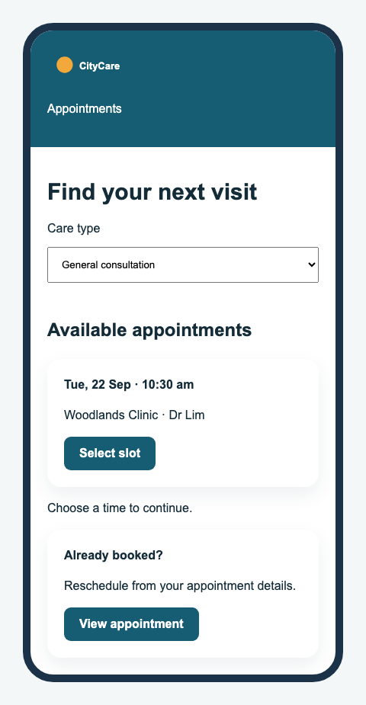
CITYCARE / DESIGN EVIDENCE
Lab 01 · Clinic Booking Mobile specimen
Review criterion
390 px mobile; appointment completion <= 45 seconds; large text and clear recovery
Mastering UI Design Techniques for Web and Mobile · TGS-2021010046
202

Slide 203
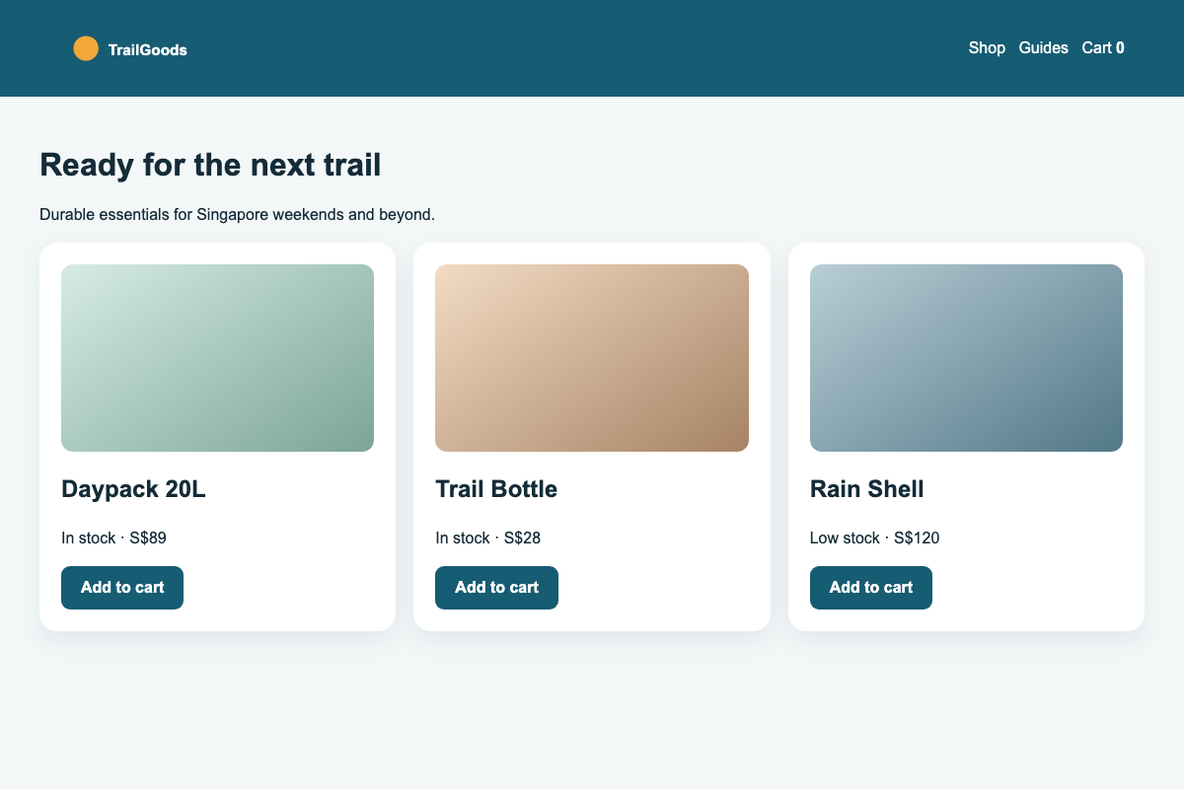
TRAILGOODS / DESIGN EVIDENCE
Lab 02 · Responsive Retail Web specimen
Review criterion
1440/768/390 px; card and button variants; keyboard focus
Mastering UI Design Techniques for Web and Mobile · TGS-2021010046
203

Slide 204
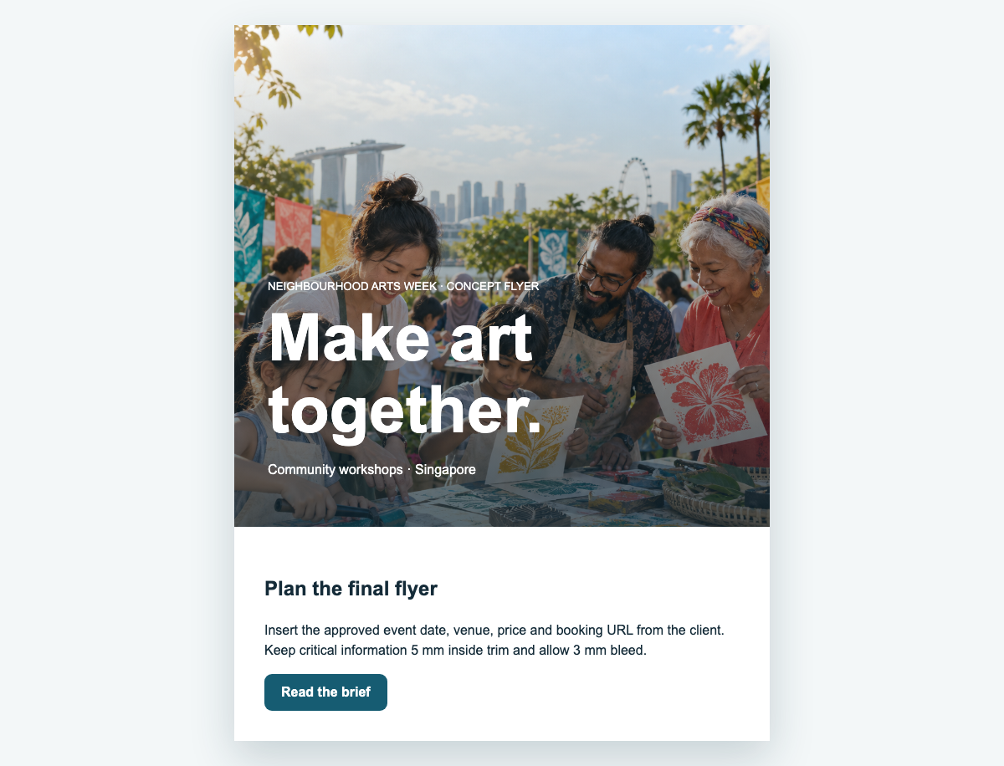
NEIGHBOURHOOD ARTS WEEK / DESIGN EVIDENCE
Lab 03 · Festival Flyer and Landing Page specimen
Review criterion
3 mm bleed; 5 mm safe zone; matching event details
Mastering UI Design Techniques for Web and Mobile · TGS-2021010046
204

Slide 205
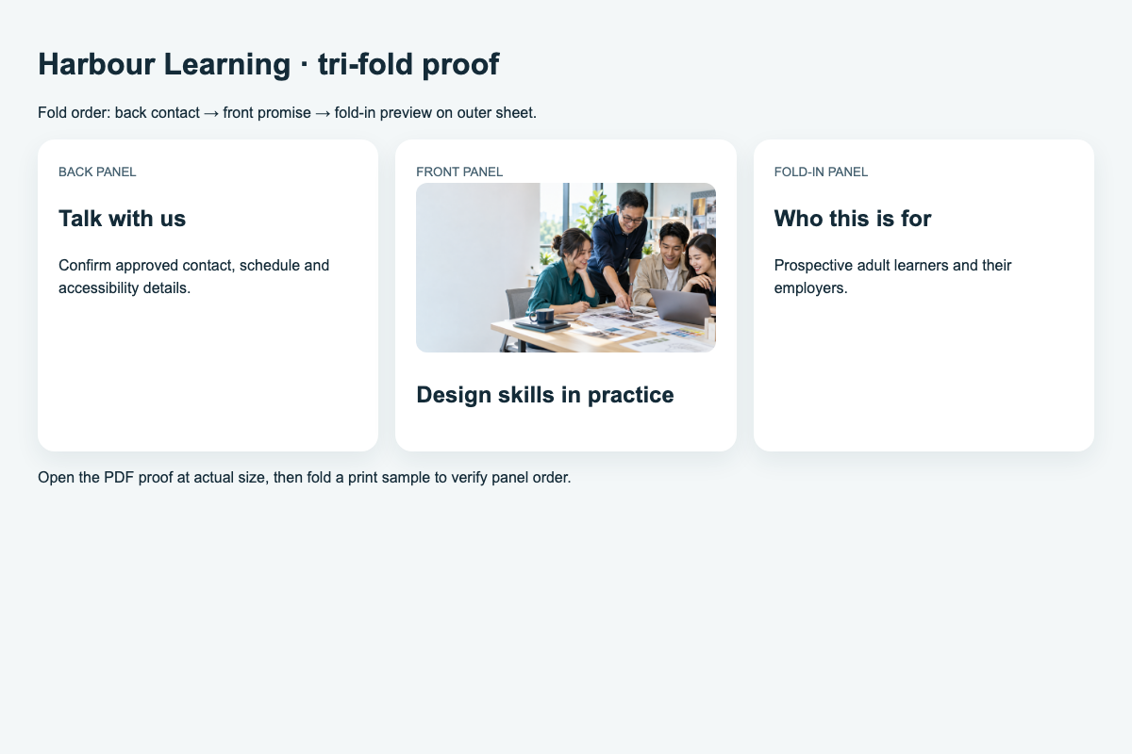
HARBOUR LEARNING / DESIGN EVIDENCE
Lab 04 · Programme Brochure specimen
Review criterion
Correct panel order; readable type; factual schedule and contact
Mastering UI Design Techniques for Web and Mobile · TGS-2021010046
205

Slide 206
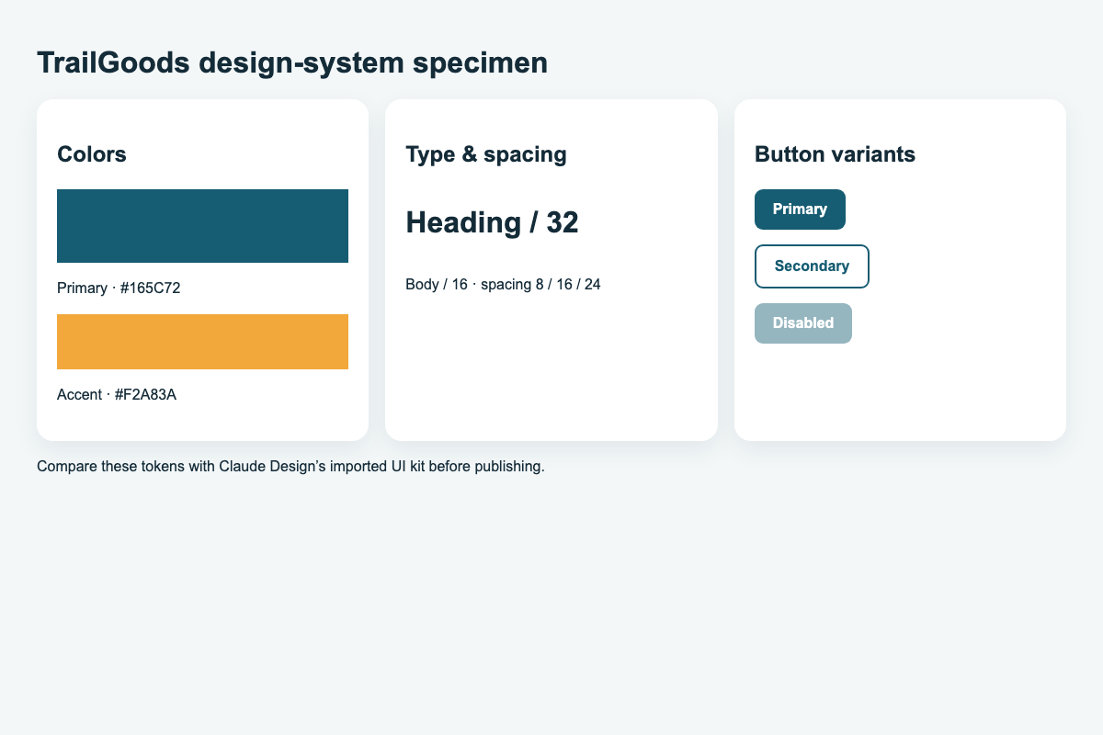
TRAILGOODS / DESIGN EVIDENCE
Lab 05 · Claude Design System specimen
Review criterion
Review imported tokens and publish only after comparison
Mastering UI Design Techniques for Web and Mobile · TGS-2021010046
206

Slide 207
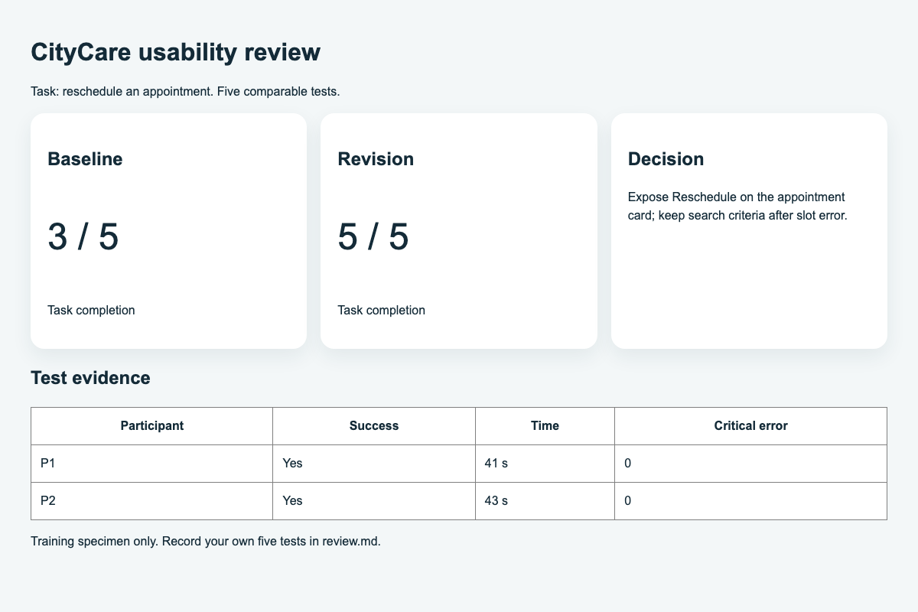
CITYCARE / DESIGN EVIDENCE
Lab 06 · Validation and Handoff specimen
Review criterion
Five tests; success/time/error rules; export current design
Mastering UI Design Techniques for Web and Mobile · TGS-2021010046
207

Slide 208
LO3 / A5
Usability test results · worked example
Decision
Five comparable tests show task success rising from 3/5 to 5/5. Verify the same task and criteria.
Mastering UI Design Techniques for Web and Mobile · TGS-2021010046
208

Slide 209
WA → PP → SIGN-OFF
Assessment flow
01
02
03
04
Written Assessment · K1–K3
Practical Performance · A1–A7
Assessor feedback · C or NYC
Summary record and sign-off
›
›
›
Mastering UI Design Techniques for Web and Mobile · TGS-2021010046
209

Slide 210
LO4 / A6–A7
Final design handoff
01
02
03
04
Current export
Token and state specification
Change log + test evidence
User guide and acceptance checklist
›
›
›
Mastering UI Design Techniques for Web and Mobile · TGS-2021010046
210

Slide 211
COURSE CLOSE
Thank you
Design for real tasks.
Validate with evidence.
Mastering UI Design Techniques for Web and Mobile · TGS-2021010046
211

